Slide 1

FARM ASSIST – A DECISION SUPPORT SYSTEM FOR FARMERS
by
A. Sai Surya Anurag
168297601001
Under the Esteemed Guidance of
Prof. P. Suresh Varma
Department of Computer Science and Engineering
Adikavi Nannaya University

Slide 2
ABSTRACT
“DECISION SUPPORT SYSTEM FOR FARMERS” is a new and simplified approach to the farming. This project is an Android Application which intends to help the Indian Farming community to aid their decision making in some aspects of Agriculture. This project aims to provide an integrated and accessible Decision Support System to ease the thought process of Farmers by suggesting a set of crops that are favourable to grow, based on Monsoon, Weather Conditions and Soil Texture. This Application also helps the Farmers to identify Leaf Diseases using Deep Learning. The main idea is to allow Farmers to gain a better understanding of the situation on the ground through advanced technology that can tell them more about their situation than that seen with the naked eye at no price. This Application, is an example to develop the farming approach in India using latest technological advancements in a fruitful manner.

Slide 3
EXISTING SYSTEM
Tremendous Research in digitalizing decision support in Indian agriculture yielded many useful applications, each contributing to support decision making in a single phase either in crop selection or disease detection or yield improvisation, but there is no reliable integrated solution for Decision Support.
Indian Government has deployed many web applications which are not convenient for direct usage by the farmers. Hence the crop recommendation by government is done manually through Agricultural Officers which may sometimes be delayed and sometimes the situation becomes worst due to corrupt officials.
Many Startups emerged in this field release commercial IoT based applications which needs extra subscriptions and cannot fully support the farmer in a potential way.
Many Decision Support Systems existed today use traditional techniques which are less reliable.

Slide 4
PROPOSED SYSTEM
Proposed system is an Integrated Decision Support System which is an Android based Application which helps the farmer in few aspect of decision making through latest technology.
DSS are software-based systems that gather and analyse data from a variety of sources. Their purpose is to smoothen the decision-making process for management, operations, planning, and simply recommends optimal solution path. It helps farmers to solve complex issues related to crop production
This application provides appropriate suggestions related to farming and thus can greatly reduce the damage caused due to improper awareness and age-old information.

Slide 5
SYSTEM REQUIREMENTS
I) Functional Requirements
Obtain and display Soil Texture
Recommend a set of crops that are favourable to grow in a particular location.
Identify the Disease caused to the plant
Should use Automated methods for Input Collection

Slide 6
II) Non Functional Requirements
Reliability : This System should work at any time the farmer wishes to use it for crop recommendations and should provide accurate results.
Scalability : The system must be scalable to any precise farm location in India
Performance : The system should give results instantaneously as farmer is not aware of such things and may consider the system is not working.
Usability : As the farmer is not acquainted well with technology, It is necessary to create a hassle free interface.

Slide 7
III) SOFTWARE REQUIREMENTS
Operating System : Windows 10
IDE : Android Studio 4.0, Google Colab
Languages : Python, Java
IV) HARDWARE REQUIREMENTS
Processor : Intel i7 3rd gen
RAM : 8GB
Graphic Card : Nvidia GeForce GT 710 2GB

Slide 8
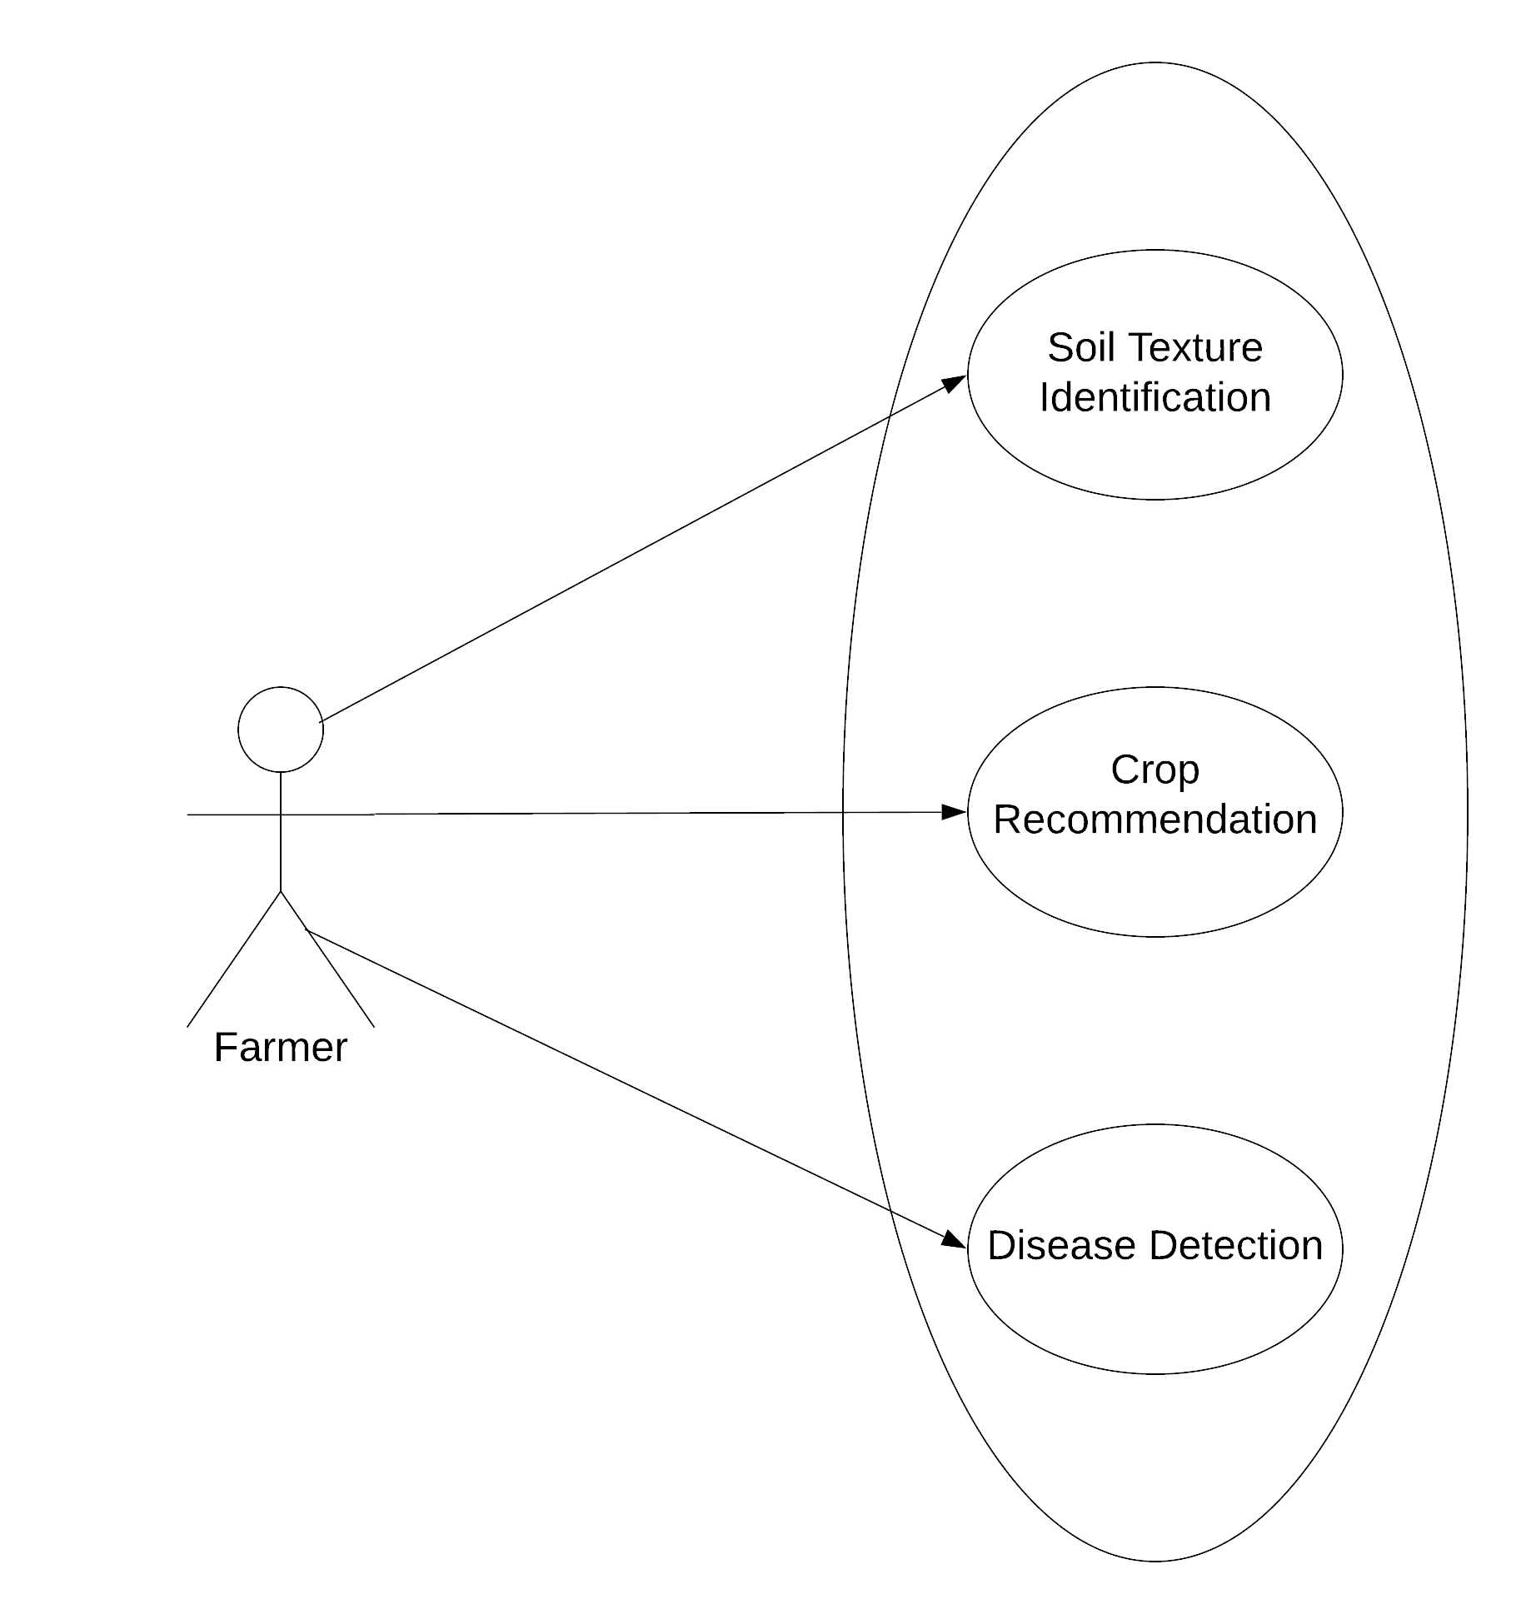
SYSTEM DESIGN
USE CASE DIAGRAM

Slide 9
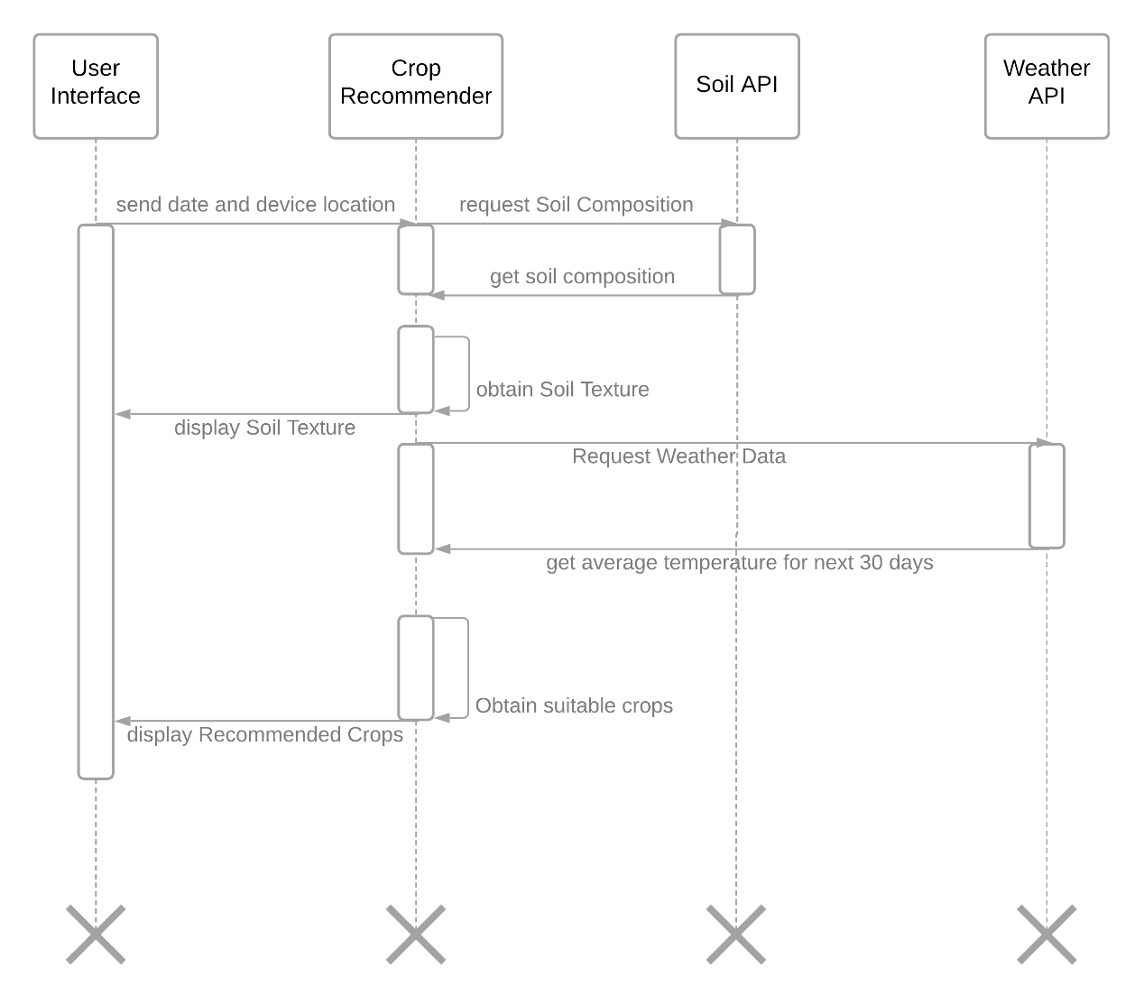
SEQUENCE DIAGRAM FOR CROP RECOMENDATION

Slide 10
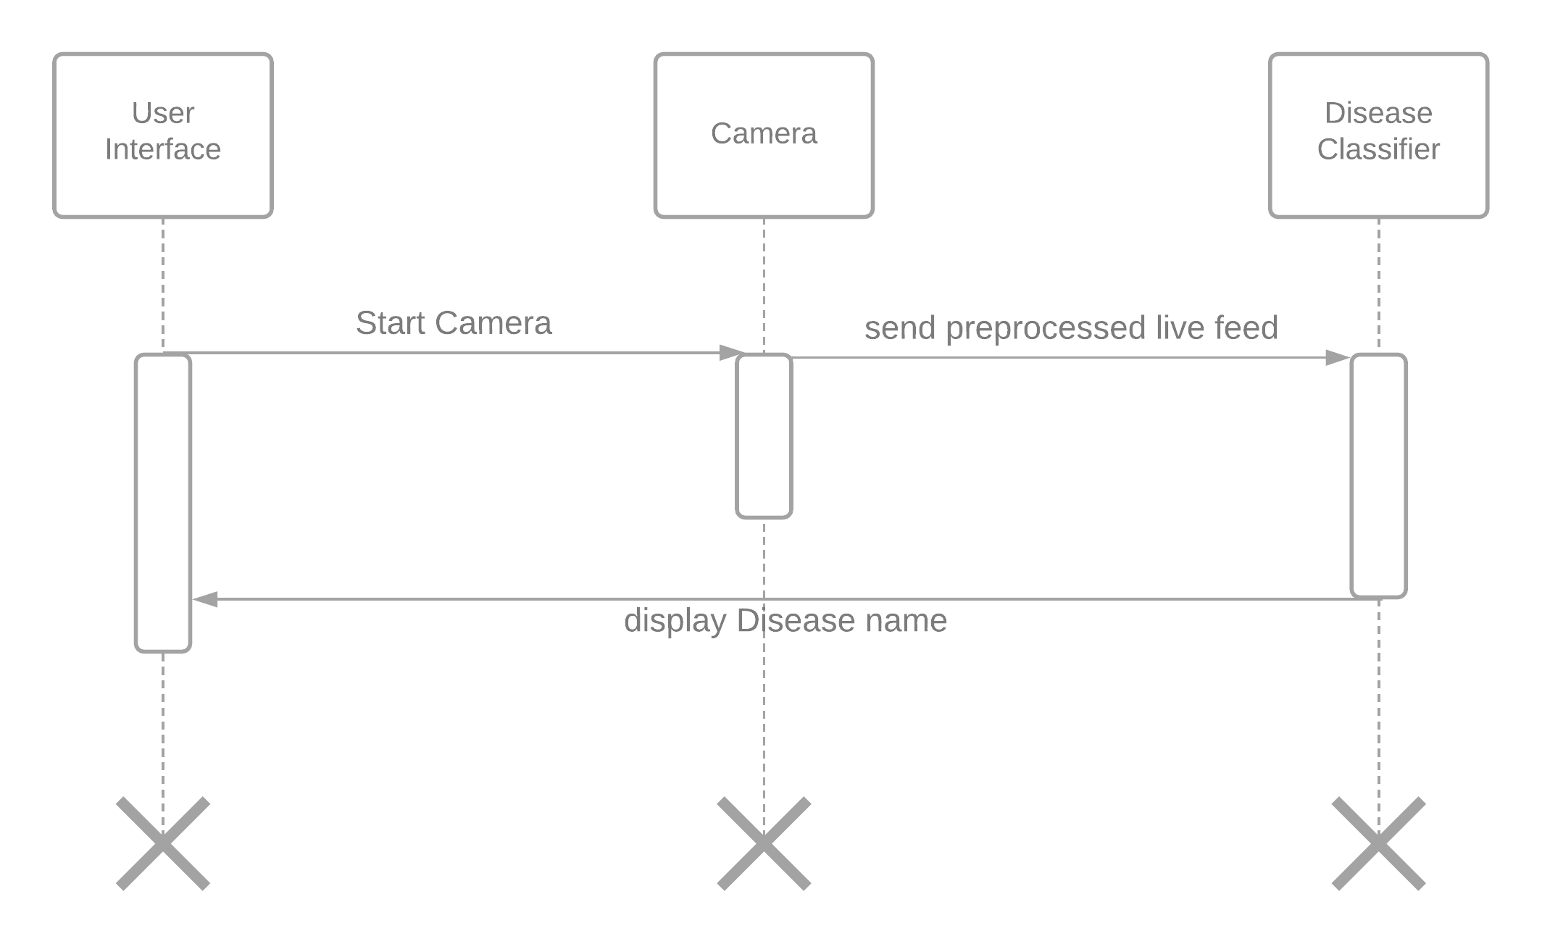
SEQUENCE DIAGRAM FOR DISEASE DETECTION

Slide 11
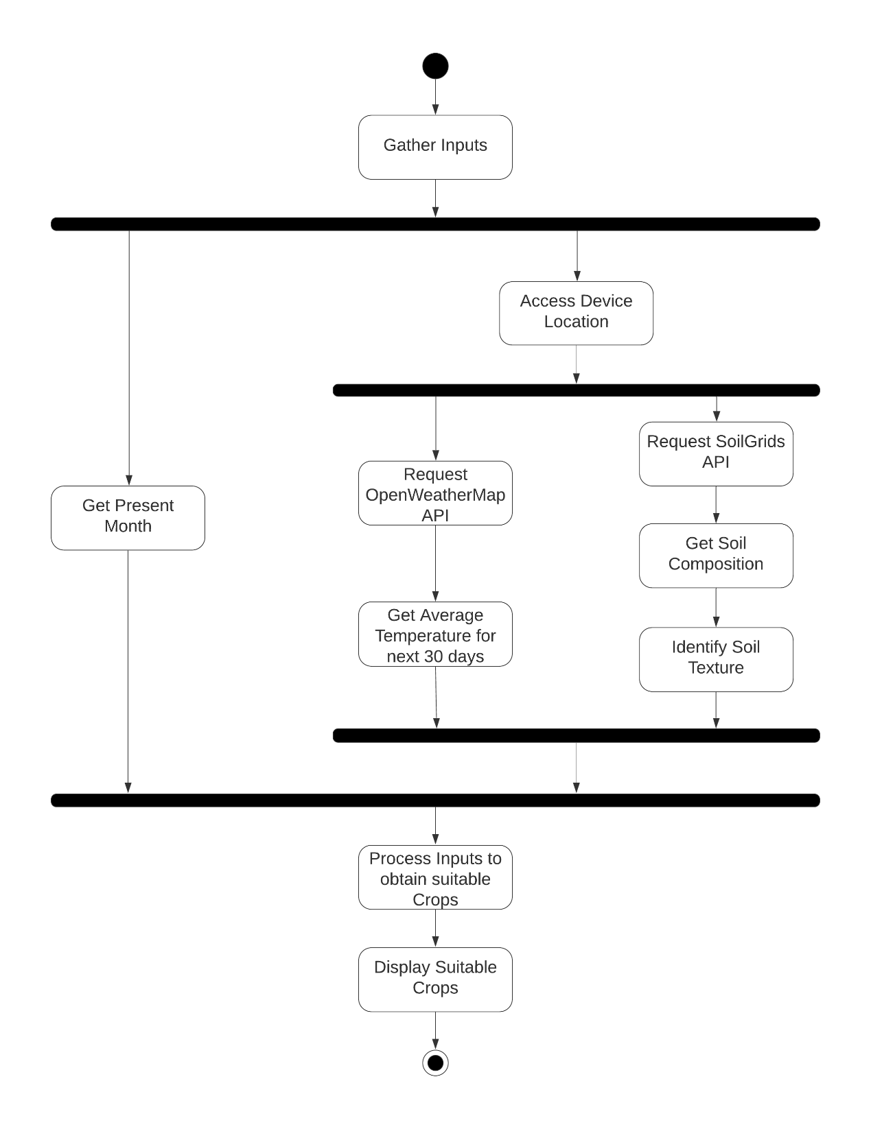
ACTIVITY DIAGRAM FOR CROP RECOMENDATION

Slide 12
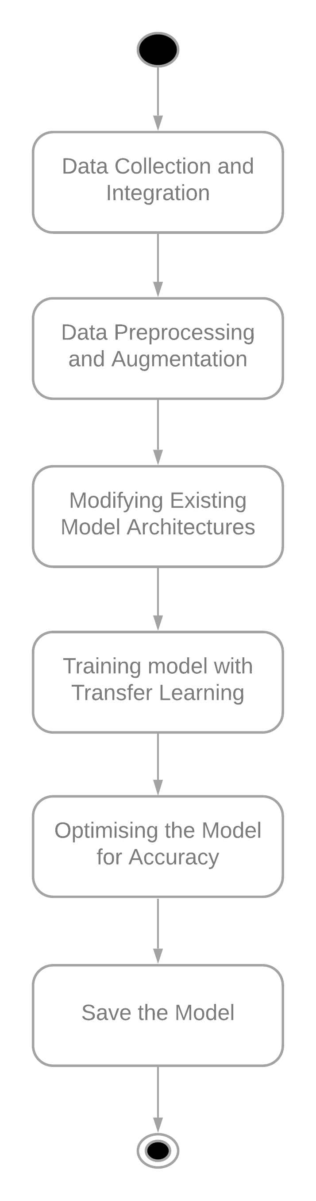
ACTIVITY DIAGRAM FOR DISEASE CLASSIFIER

Slide 13
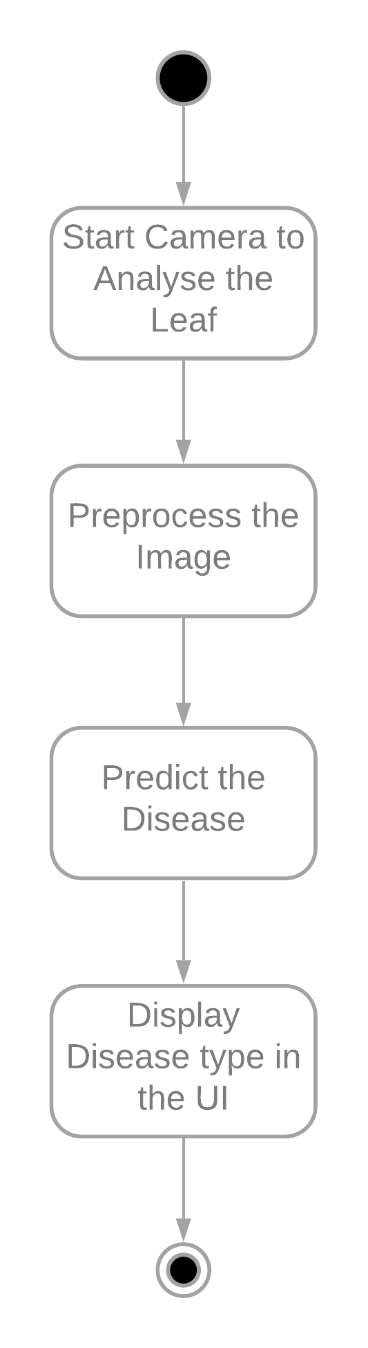
ACTIVITY DIAGRAM FOR DISEASE DETECTION

Slide 14
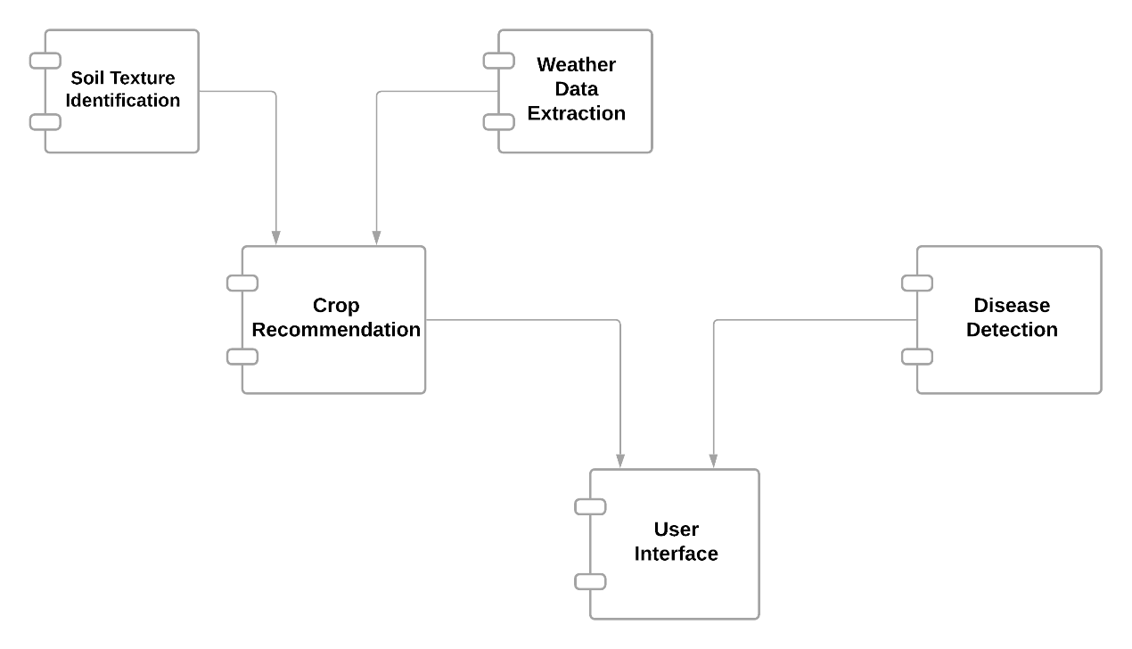
COMPONENT DIAGRAM

Slide 15
IMPLEMENTATION
I) CROP RECOMMENDATION MODULE
a) Fundamental prerequisite
we acquire information about crop and its suitable growing conditions like type of soil, favourable temperature and suitable periods of initial seed sowing from the following sources :
1. data.gov
2. fao.org
3. farmer.gov.in
4. agropedia.iitk.ac.in

Slide 16
IMPLEMENTATION
b) Congregating Inputs
In this system, Inputs are collected without any manual intervention of the user(farmer). The following are the inputs required for recommending suitable crops.
i) Weather Data
World weather online API gives real time information of several weather parameters. The average temperature over the upcoming 30 days is calculated and taken as one of the input prerequisites for crop selection.

Slide 17
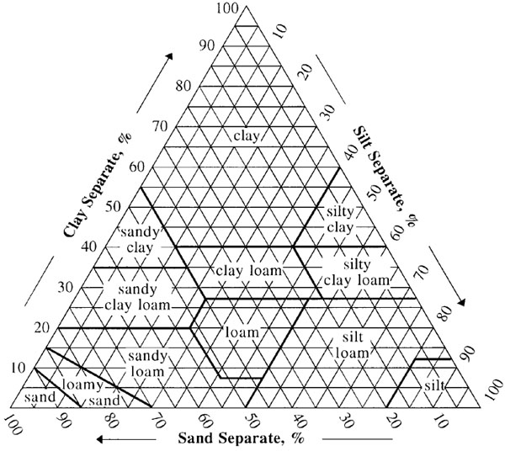
IMPLEMENTATION
ii) Soil Texture
SoilGrids API gives us the percentage of each component in that particular soil i.e. silt, clay and sand. This real time percentage generated is compared with the static information from USDA Soil Texture Triangle.

Slide 18
IMPLEMENTATION
c) Output (List of Suitable Crops) :
After determining the inputs, we validate the crops list information prepared earlier with the above obtained inputs and the current month (obtained from system date) through simple conditional statements. Then we display the list of recommended crops in UI along with the soil texture.

Slide 19
IMPLEMENTATION
II) DISEASE DETECTION MODULE
i) Data Collection
It is formed from multiple datasets which include PlantVillage dataset (a research dataset by PSU-USA), Citrus leaf diseases dataset and Rice leaf diseases dataset. It has a total of 46 classes out of which there are 31 diseased leaf categories , 14 healthy leaf categories and 1 category for image without leaves.

Slide 20
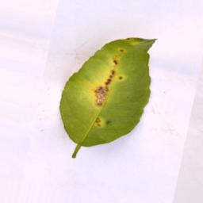
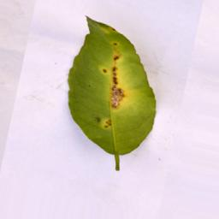
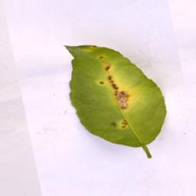
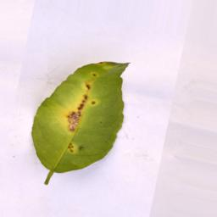
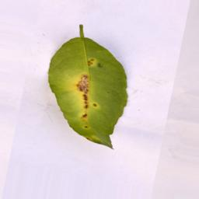
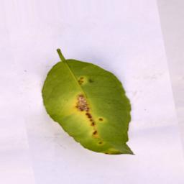
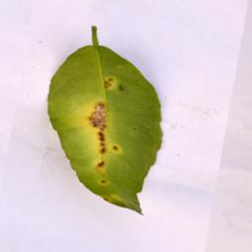
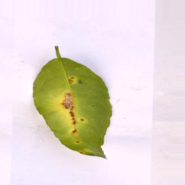
IMPLEMENTATION
ii) Data pre-processing :
Data Augmentation : Technique to increase the diversity of the training set by applying transformations like Scaling, Cropping, Flipping, Rotation, Brightness, Saturation etc.

Slide 21
IMPLEMENTATION
iii) Model Development
MobileNetV1 is the model used for disease detection. It is a lightweight architecture with high computational efficiency created for mobile applications.
MobileNet is a deep Convolutional Neural Network developed by Google based on the Xception Architecture. The core layer of MobileNet and Xception architecture is depthwise seperable filters, known as Depthwise Seperable Convolution.

Slide 22
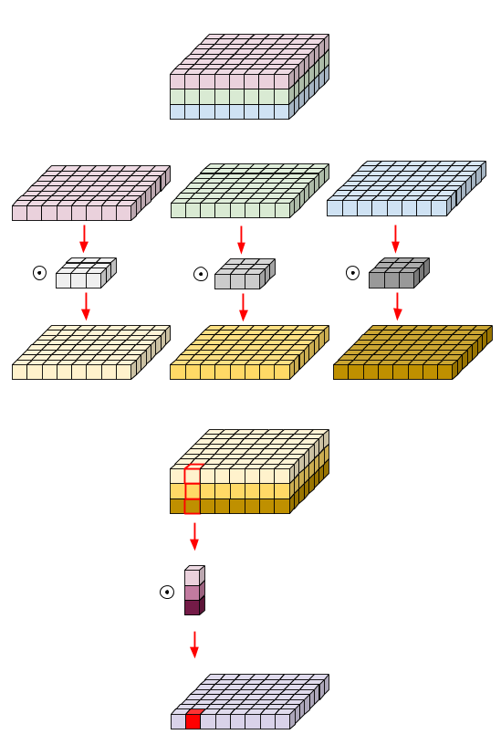
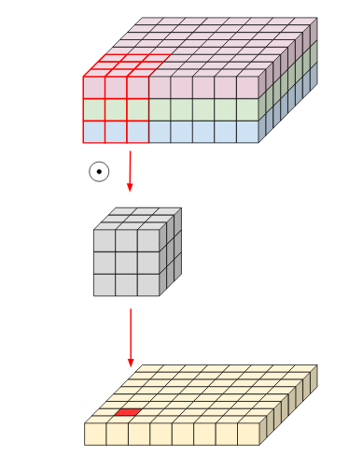
IMPLEMENTATION
STANDARD CONVOLUTION
DEPTHWISE SEPERABLE CONVOLUTION

Slide 23
IMPLEMENTATION
iv) Export the model to Tflite
TensorFlow Lite is a set of tools to help developers run TensorFlow models on mobile, embedded, and IoT devices The Model thus saved is converted into Tflite and then embedded into Android Application for running inference using Tflite interpreter.

Slide 24
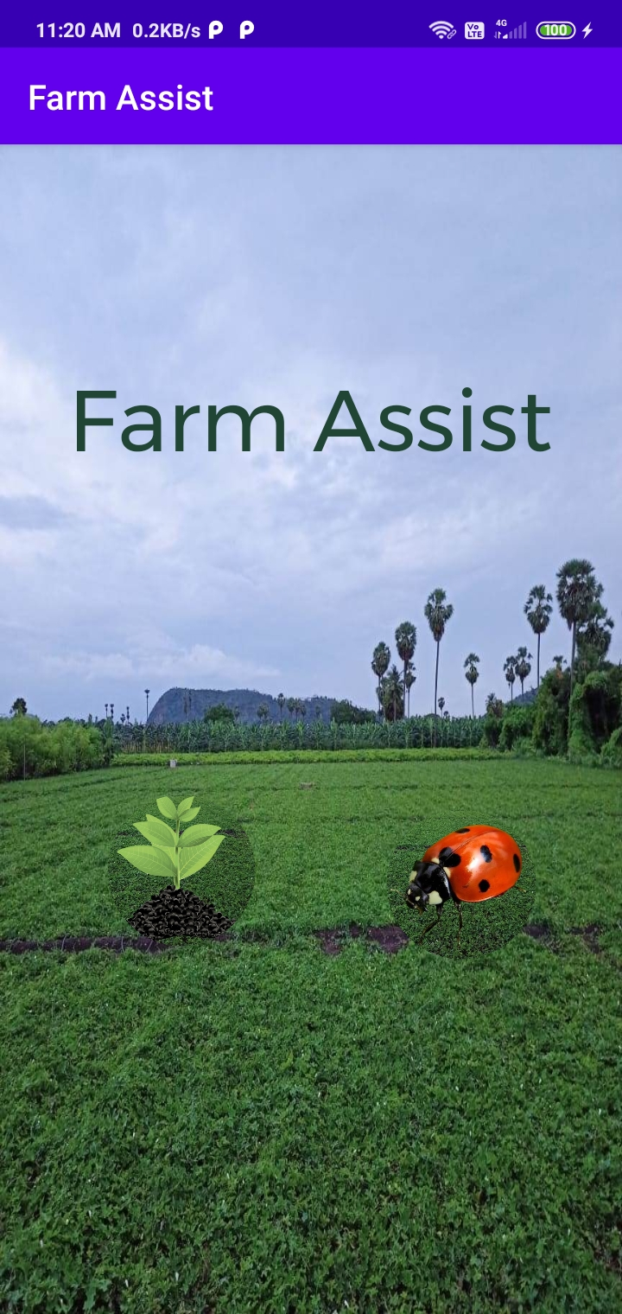
HOME SCREEN

Slide 25
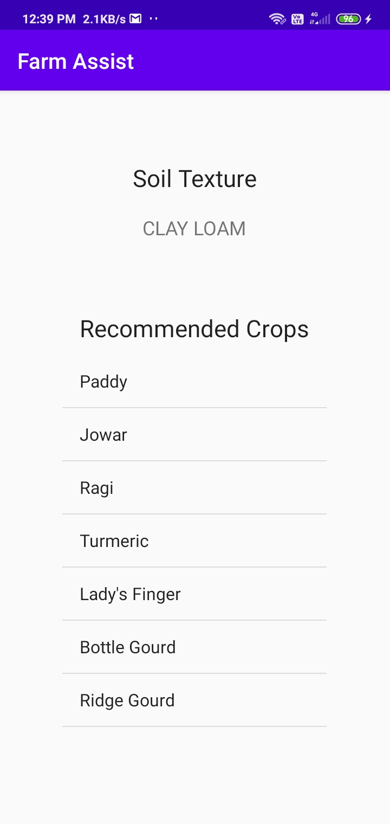
CROP RECOMMENDATION

Slide 26
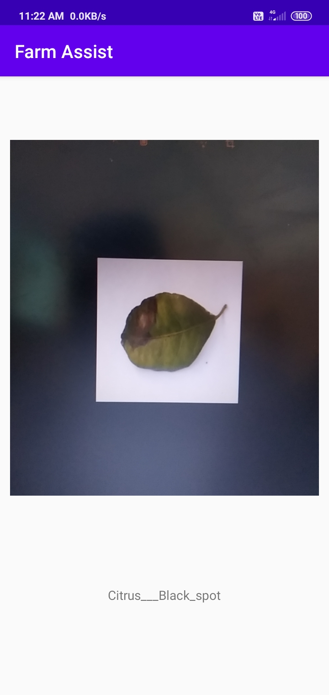
DISEASE DETECTION

Slide 27
THANK YOU

